Slide 1
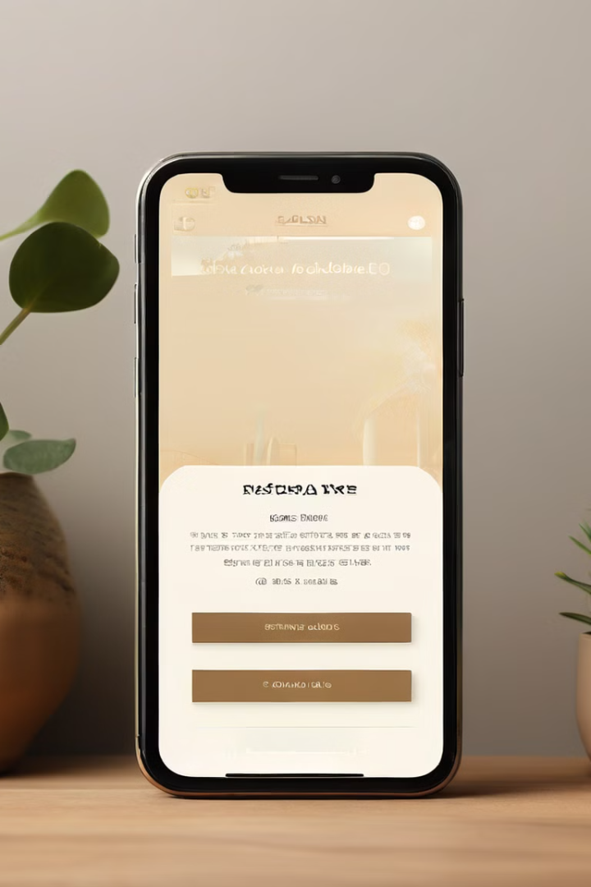

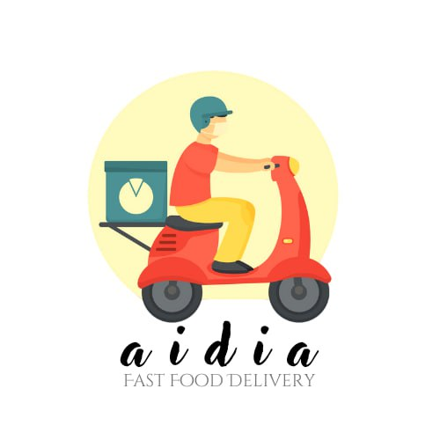

Food Ordering Mobile Application
AIDIA, our innovative food delivery app, was created by combining the first initials of our talented team members. With a clean, user-friendly interface, AIDIA puts the power of convenient meal ordering at your fingertips.
Team Members:
COHNDSE233F-025 R.M.I.T RATHNAYAKE COHNDSE233F-027 S.M.A DILMIKA COHNDSE233F-048 K.K.D.D WIJETHISSA COHNDSE233F-076 M.A.I.C HANSIKA COHNDSE233F-092 G.A.U AMANDA
Guided By: Ms. P D C Ranaweera

Slide 2
Key Functionalities
User Authentication
Order Customization
Integrated Technologies
Secure user login and registration to ensure a personalized experience.
Customers can easily customize their orders to their liking.
The app utilizes SQLite for local data storage, camera access, and Google Map integration.

Slide 3
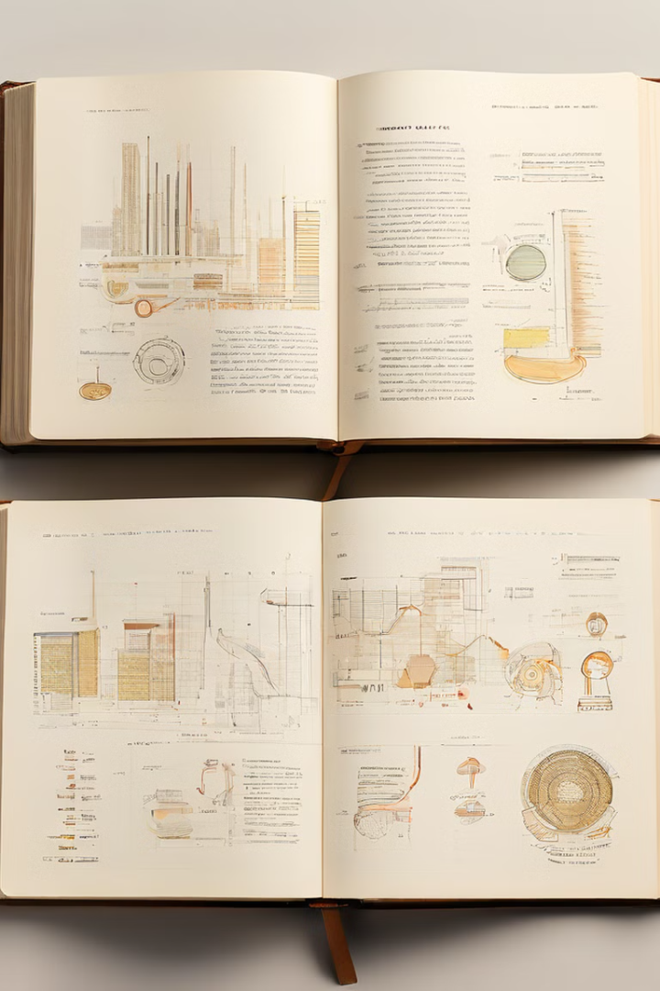
Contents
1
Introduction
2
System Design
Outlining the app's purpose and key features.
Detailing the app's components and architecture.
3
User Interfaces
4
Exception Handling
Showcasing the customer and admin interfaces.
Ensuring a seamless user experience.

Slide 4

Introduction
Streamlining the Process
Enhanced Capabilities
The app is designed to simplify the food ordering process, providing users with a user-friendly interface.
The app offers features for both customers and administrators, catering to their specific needs.
Real-Time Notifications
Efficient Administration
Customers can receive real-time updates on the status of their orders.
Administrators can manage menus, track orders, and analyze sales data with ease.

Slide 5
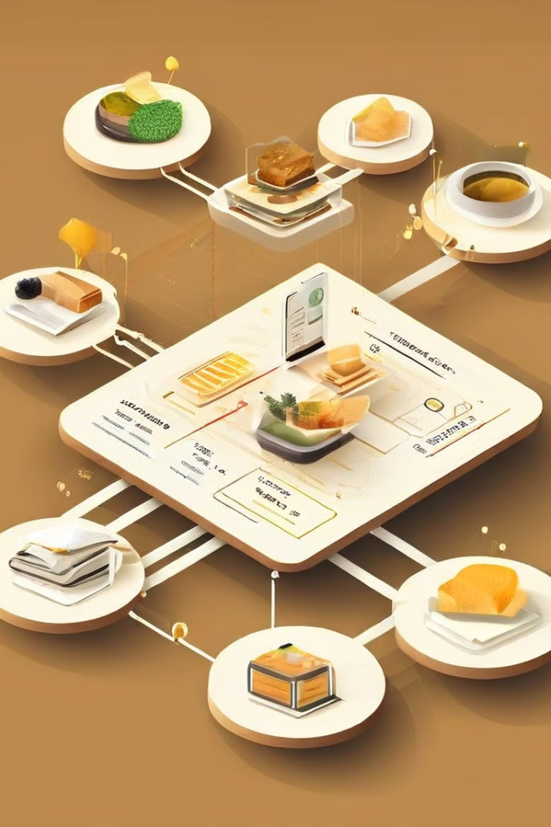
System Design
1
User Authentication
Secure login and registration system to ensure user privacy and data protection.
2
Order Management
Comprehensive order tracking and processing capabilities for seamless order fulfillment.
3
Database Integration
Efficient data storage and retrieval using SQLite, providing a reliable and scalable solution.

Slide 6
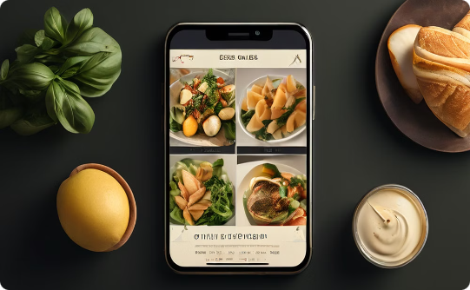
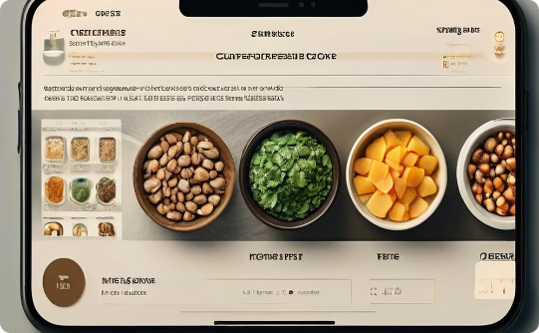
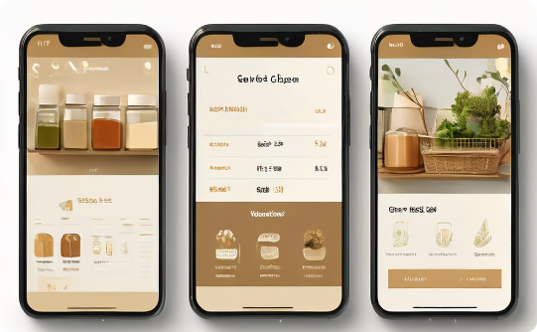
Customer User Interfaces
Menu Page
Customization
Cart View
Customers can browse through a comprehensive menu, complete with tantalizing food images and descriptions.
Customers can easily customize their orders to their personal preferences and dietary requirements.
Customers can review their order details, make any necessary adjustments, and proceed to checkout.

Slide 7




Admin User Interfaces
Secure Access
Admin Dashboard
The Admin Login Page ensures secure access to the backend features of the app.
The Admin Dashboard provides a comprehensive overview of the app's operations.
Menu Management
Sales Analysis
Administrators can easily update and manage the app's menu offerings.
Administrators can access detailed sales data and analytics to make informed decisions.

Slide 8




Conclusion
Streamlined Ordering
The app provides a seamless and user-friendly food ordering experience for customers.
Efficient Administration
The app offers robust administrative tools for managing menus, tracking orders, and analyzing sales data.
Continuous Improvement
The app is designed with a focus on scalability and adaptability to meet evolving user needs.

Slide 9
Thank You..

